Slide 1
FERRY FIRES:
Analysis of Structural and Human Factor Issues
Presented at:
Ferry Safety and Technology Conference
Manhattan, 2-3 June 2016

Slide 2
Ferry Fire Accidents
Philippine - Dona Paz (1987): over 4000 fatalities
Baltic Sea - Scandinavian Star (1990): 150 fatalities
Philippine - SuperFerry 14 (2004): 60 fatalities
Italy Sea - Vincenzo Floria (2009)
Ionian Sea (off Italy Coast) – Norman Asturias (2014): 8 fatalities
Japan sea – Sunflower Daisetsu (2015): 1 fatality
Indonesia??

Slide 3
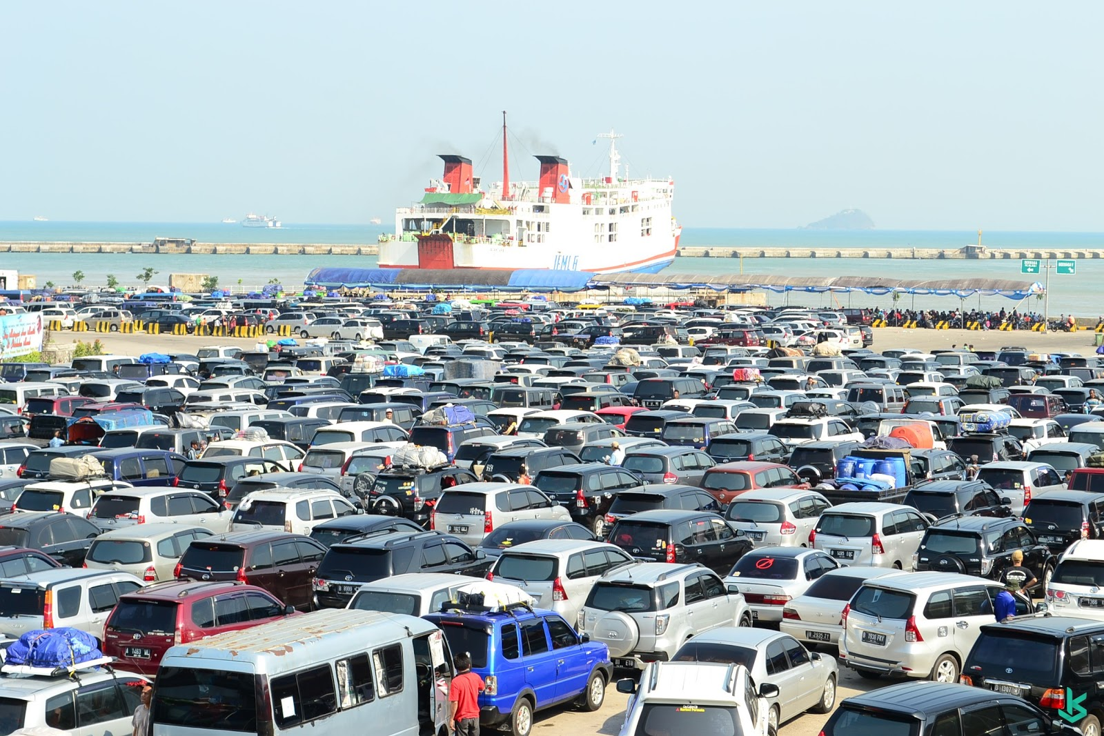
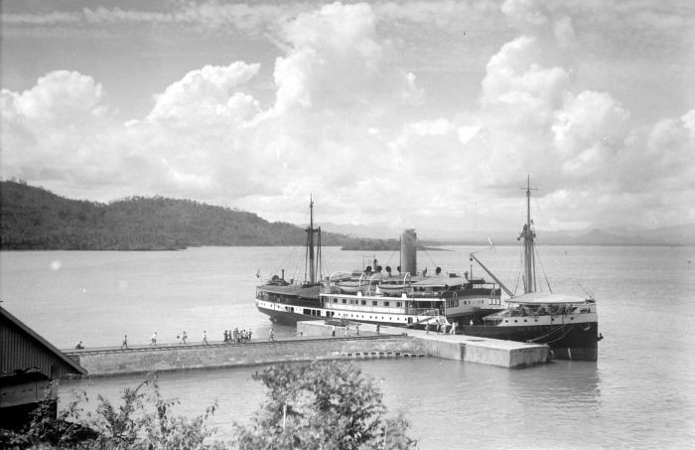
Indonesian Domestic Ropax ferry

Slide 4
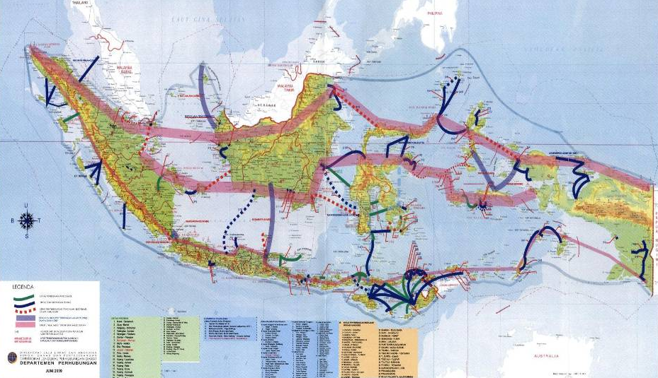
INDONESIAN FERRY SERVICE
2014 Data:
Fleet:
258 Ferry Ships (15 Pioneer ferry ships)
Lane:
48 Commercial, 169 subsidise
Loading Capacity:
50 Thousand Pax,
6 Thousand Vehicles
Ports:
210 Ferry Ports
2014 Data:
Productivity:
62. 036. 587 Pax
7. 713. 925 Vehicles
2014 Data:
Ship Age:
> 50%: over 25 years old,
5% < 5 years.

Slide 5
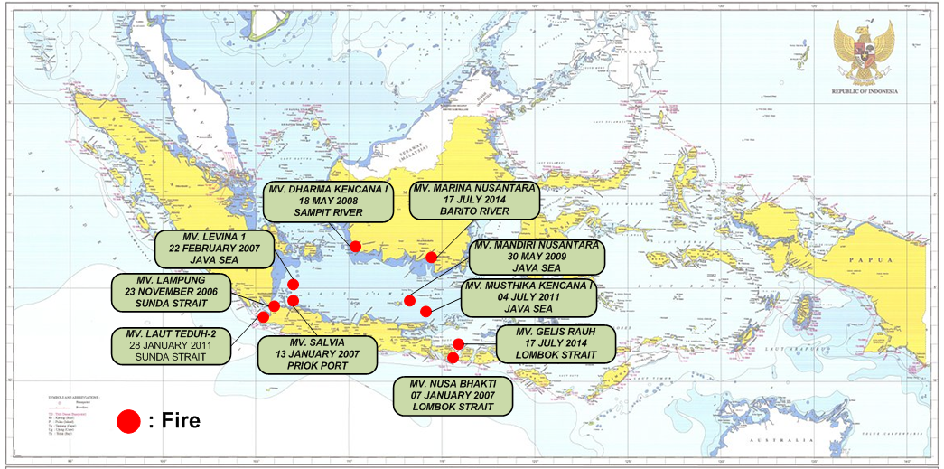
CASES OF FIRE ONBOARD FERRY ROPAX IN INDONESIA (2006 – 2014)

Slide 6
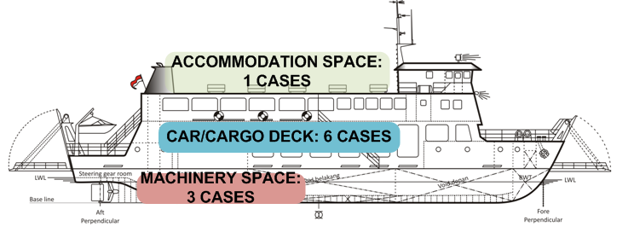
TYPICAL CONSEQUENCES BASED ON EACH TYPE OF FIRE ORIGIN:
Accommodation Space : Medium to Major Damage, Fatality/s
Car deck : Total Loss, Heavy Damaged, Fatalities
Machinery Space : Medium to Heavy Damaged

Slide 7
CONTRIBUTORY FACTORS

Slide 8
SEMOMAP’s Stages of Accident (Phase-1-3)
(Sequential models of marine accident process)

Slide 9
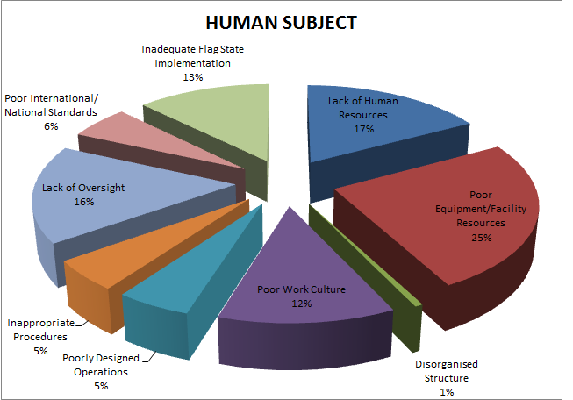
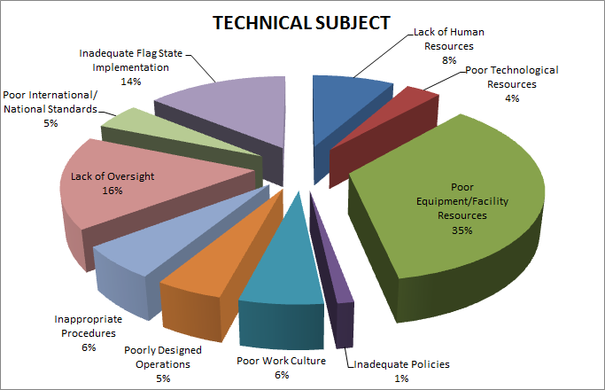
CONTRIBUTORY FACTOR ANALYSIS RESULTS
ORGANISATIONAL INFLUENCE

Slide 10
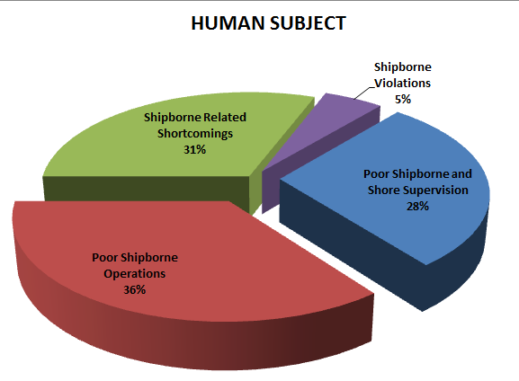
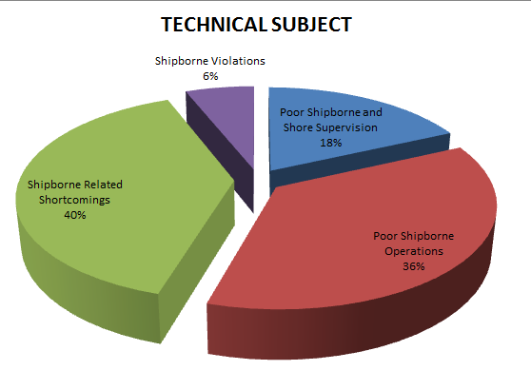
CONTRIBUTORY FACTOR ANALYSIS RESULTS
SUPERVISION

Slide 11
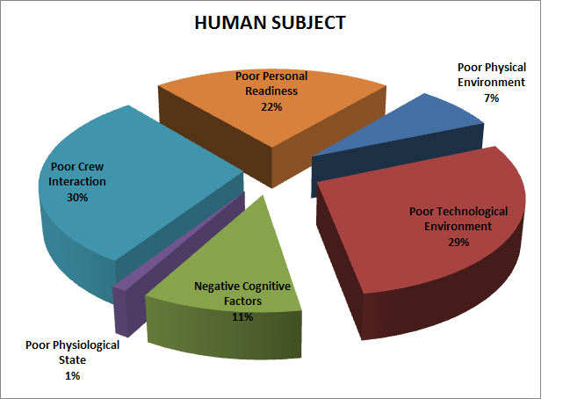
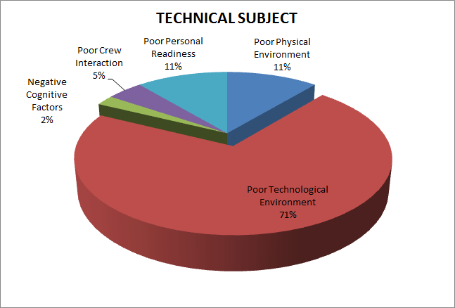
CONTRIBUTORY FACTOR ANALYSIS RESULTS
PRE-CONDITION

Slide 12
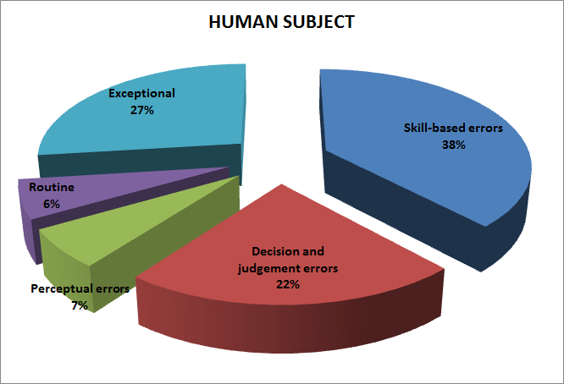
CONTRIBUTORY FACTOR ANALYSIS RESULTS
UNSAFE ACT

Slide 13
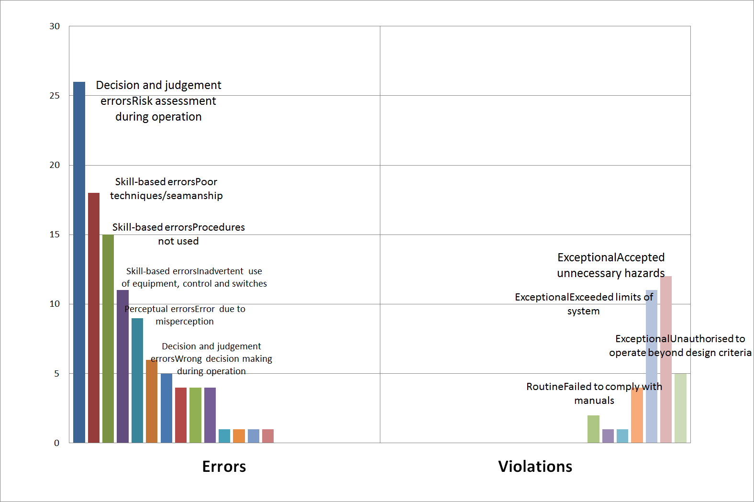
UNSAFE ACT – FIRE ONBOARD FERRY

Slide 14
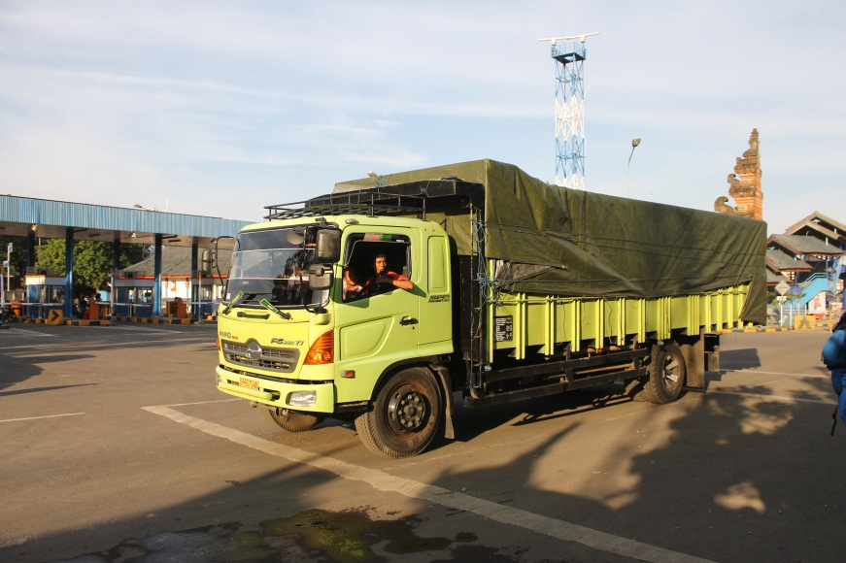
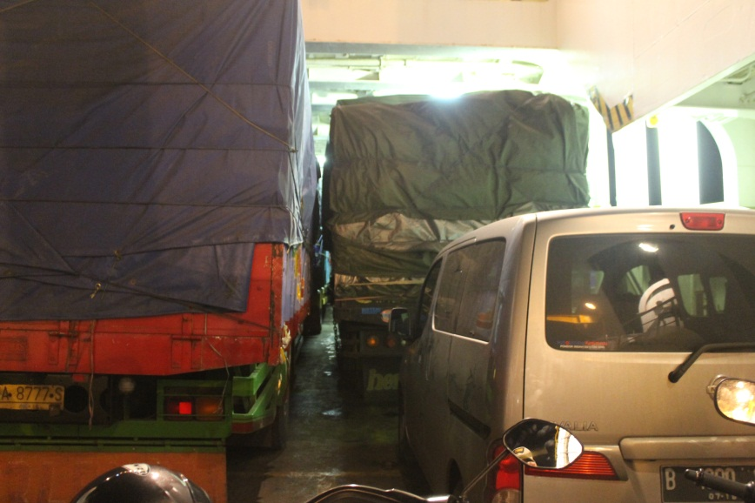
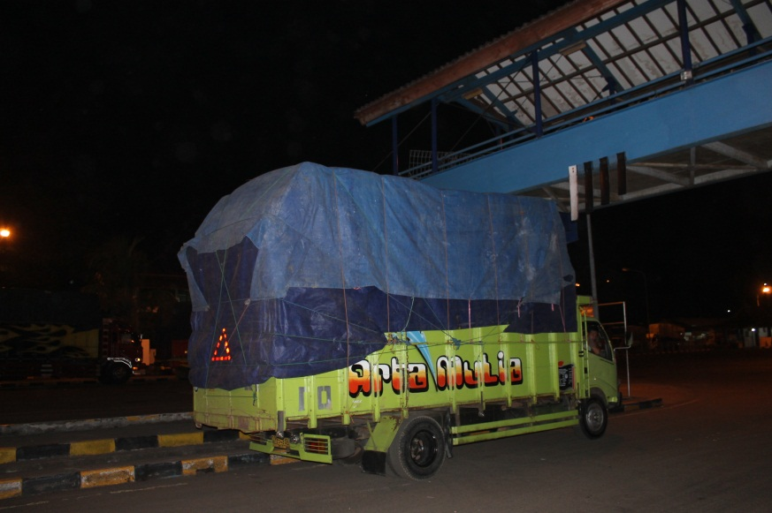
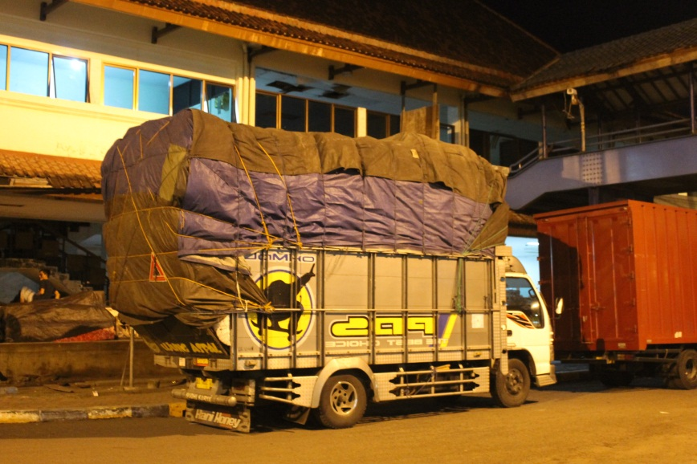
VEHICLE CONDITION
Condition of Vehicle
Layout and placement
Cargo Handling
Inspection of cargo

Slide 15
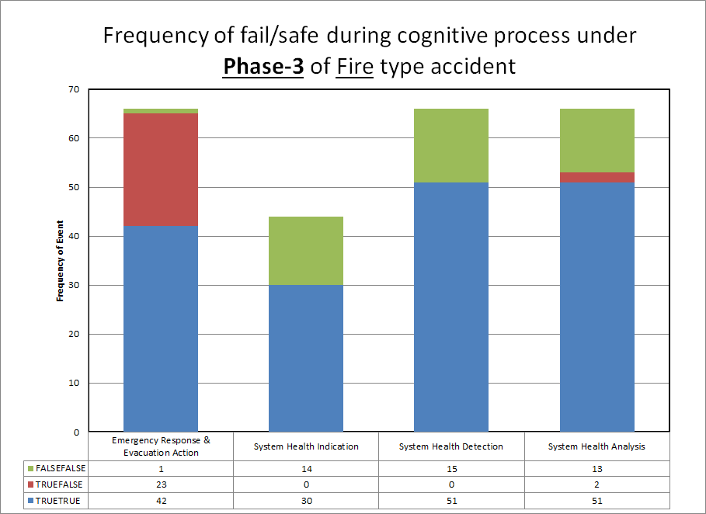
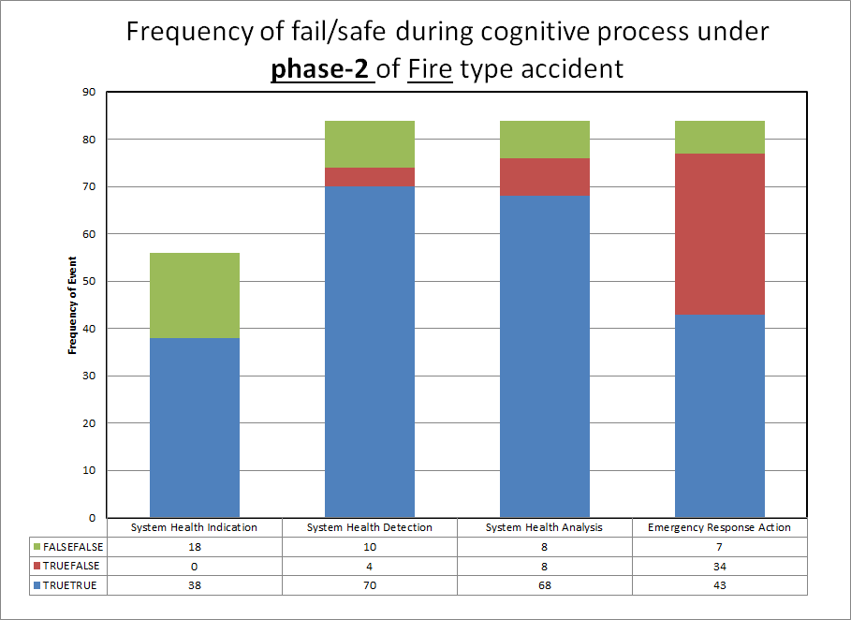
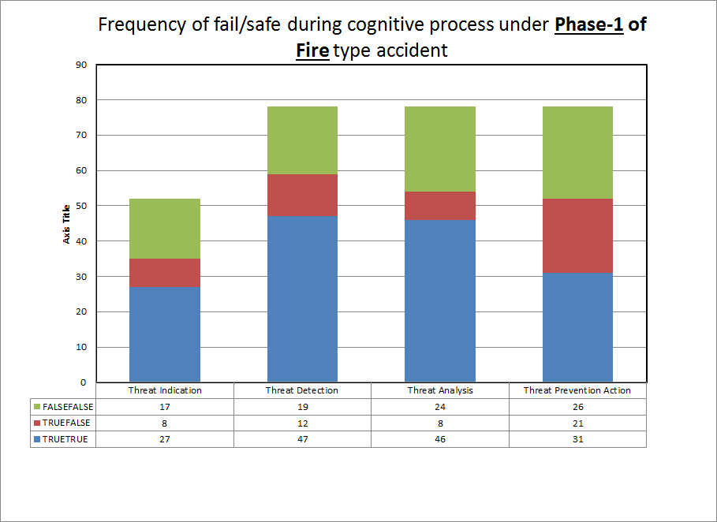
PATTERN OF FAILURE IN RORO FERRY FIRE ACCIDENT

Slide 16
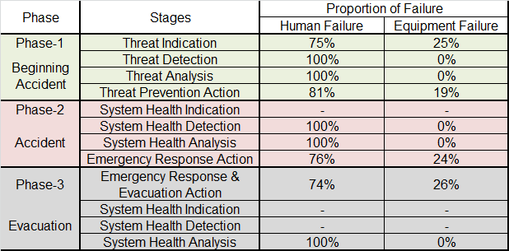
ACCIDENT DEVELOPMENT STAGES

Slide 17
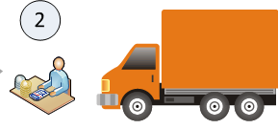
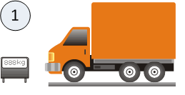
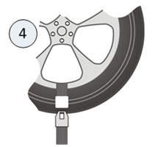
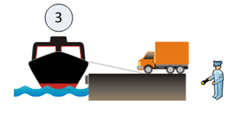
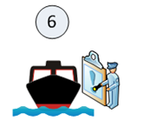
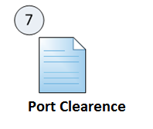

VEHICLE to SHIP FLOW PROCESS
Vehicle weighing and cargo inspection/check
Port Gate/Ticketing
Vehicle
securing
Boarding the Ship, Draft/Heeling Inspection
Pax and Cargo Manifest, Stability Calculation
Ship Physical Inspection

Slide 18
ISSUES IN FERRY PORT FACILITY
VEHICLE WEIGHING FACILITY
  Distribution Of Vehicle Weight Information
OVERWEIGHT CARGO DISCHARGING LOCATION
  Discharged overweight cargo should be kept in safe storage.
  Ineffective cargo inspection
DANGEROUS CARGO AREA
  Ship Must Not Carry Passenger While Loaded With DC
  Special area for vehicle carrying DC
PASSENGER ACCESS
  Efficient Passenger Onboard Vehicle Manifest System?

Slide 19
General Issues in Fire onboard Ropax
Shortcoming of Equipment:
  Unnecessary modification
Complacency
  Operation roster
Crew Preparedness
  Training
  Familiarisation
Control of Passengers
  Passenger manifest system
  Crowd management
  Safety information dissemination
Operational Issues
  Lack of inspection and maintenance
  Cargo space Vs. max draft
Vehicles
  Dimension extended
  Uncontrolled total weight
  Unreported hazardous cargo

Slide 20
Conclusion
Fire onboard Ferry Ropax has significant degree of difficulties:
Control of passengers;
Awareness and readiness of the crew;
Consistent supervision to the ferry operation.

Slide 21
Thank You
Jl. Medan Merdeka Timur No 5, Jakarta. 10110 INDONESIA
Telp. (+62) 21 384 7601; Fax (+62) 21 351 7606
Website :
http://www.dephub.go.id/knkt
E-mail :
knkt@dephub.go.id;
marine.knkt@dephub.go.id

